Slide 1

Flow-X/C Flow Computer
sales presentation, MARCH 2018
Flow-X series of flow computers
ABB Spirit IT – Eindhoven PMU

Slide 2
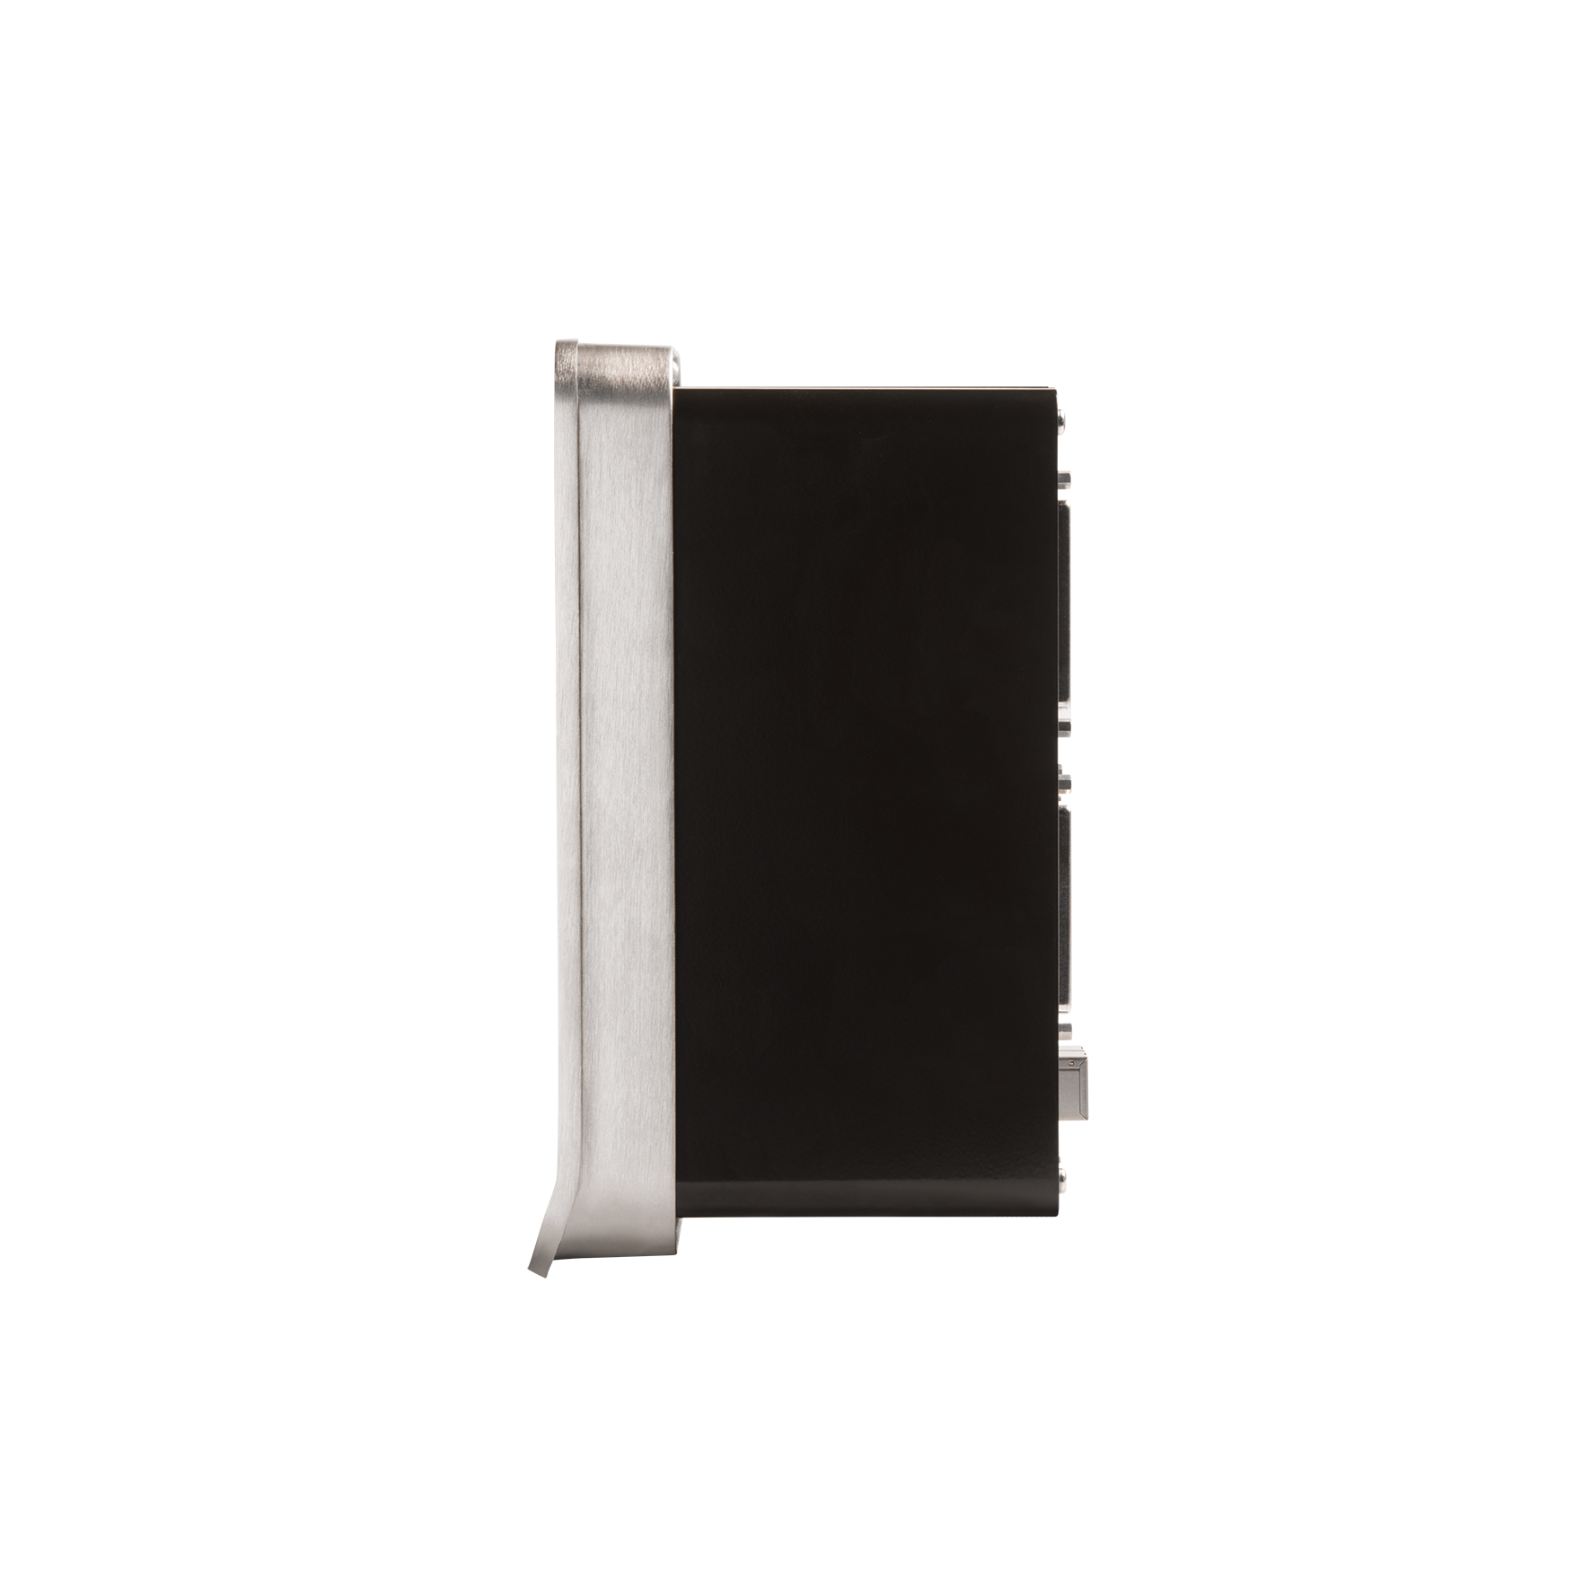
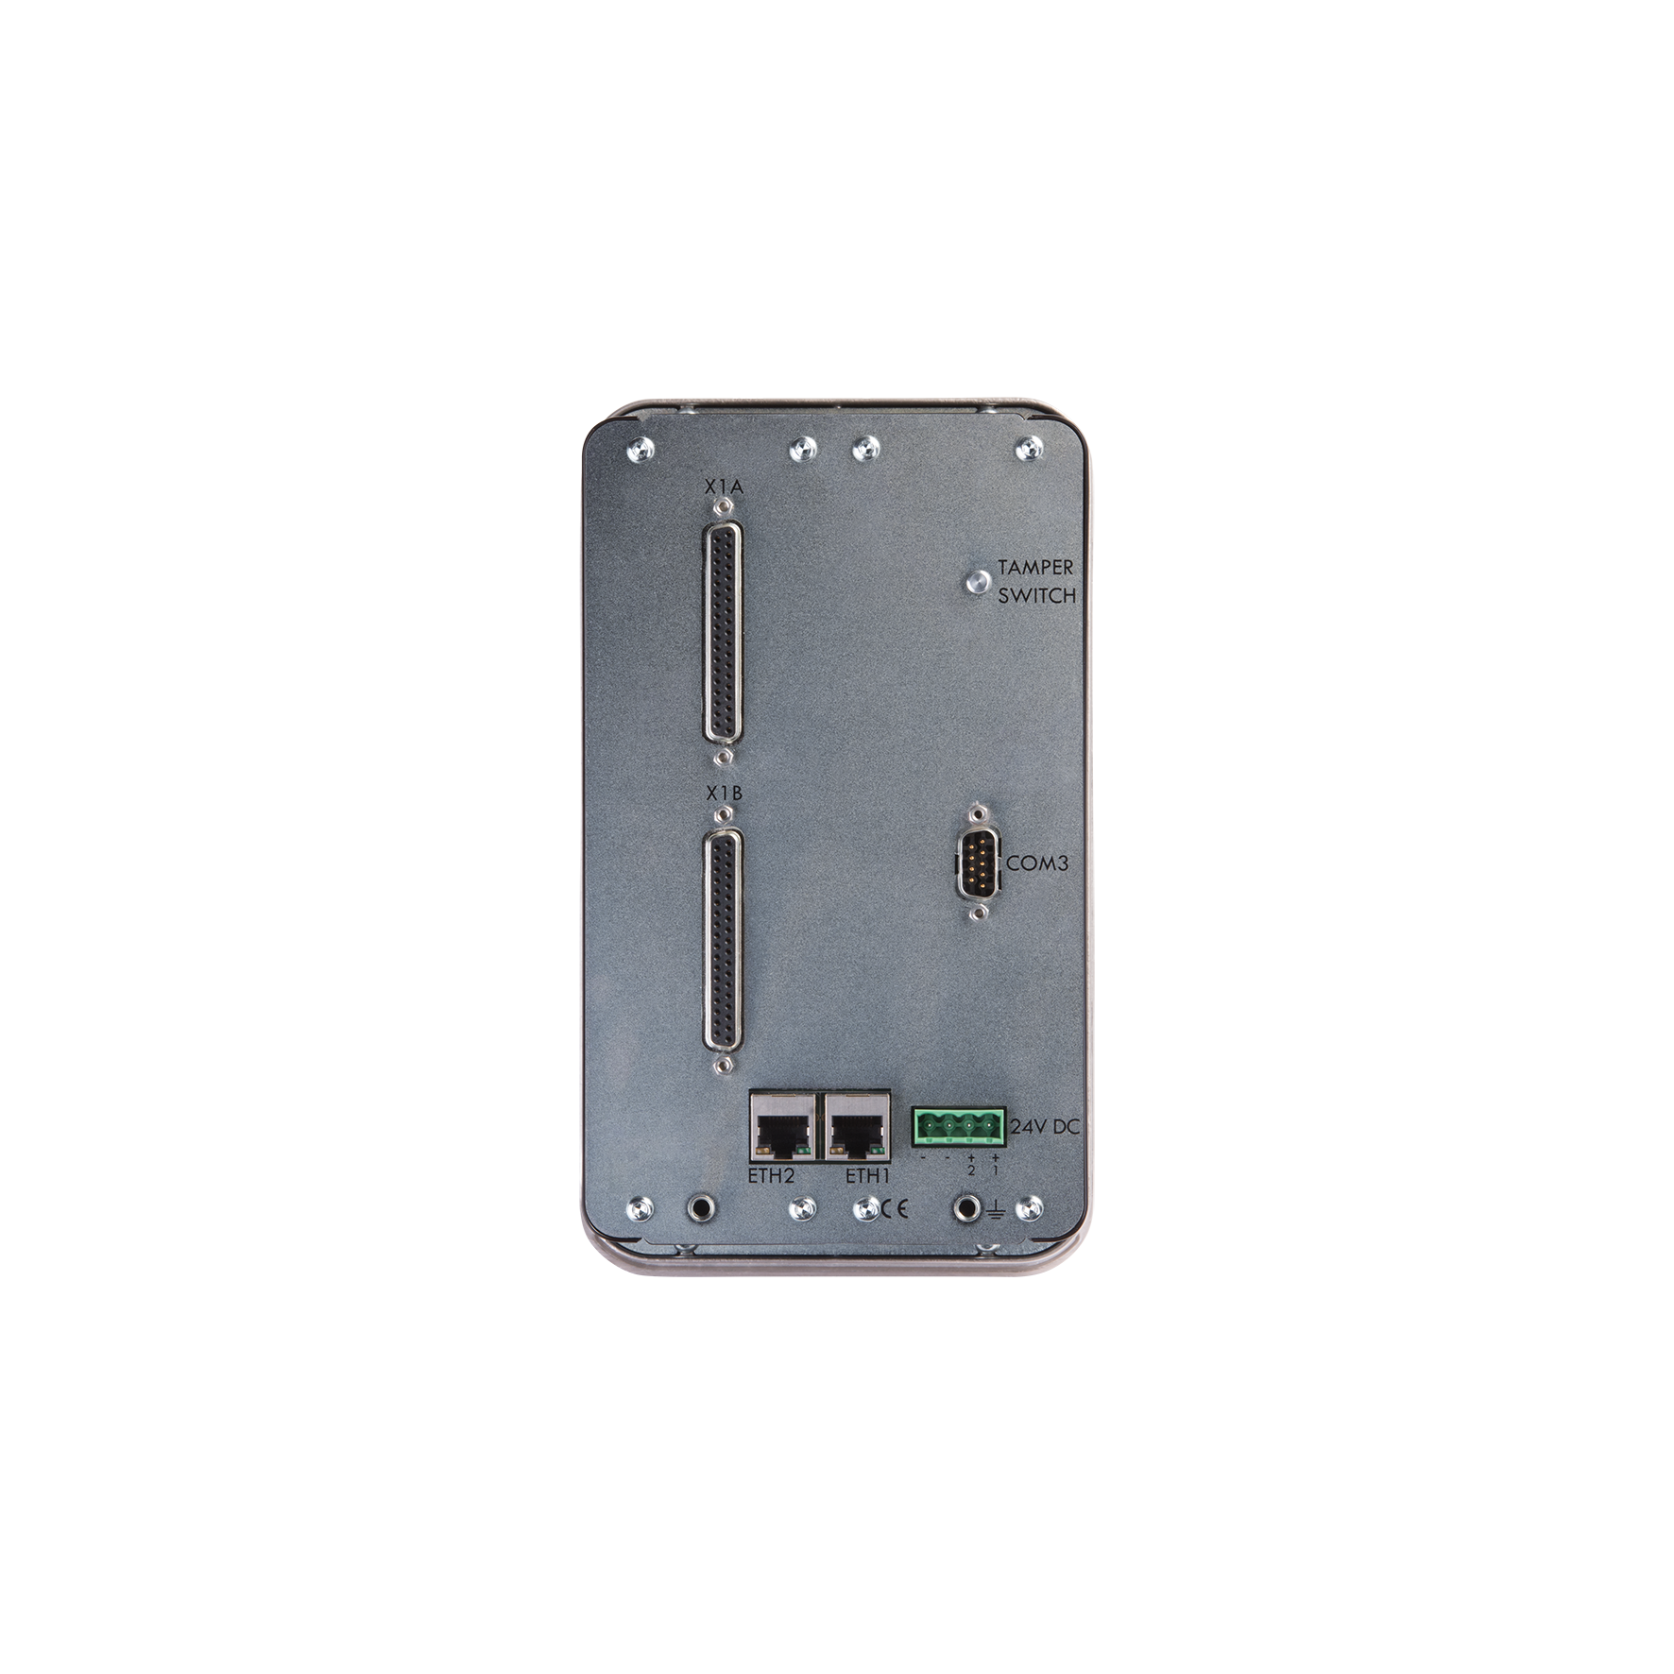
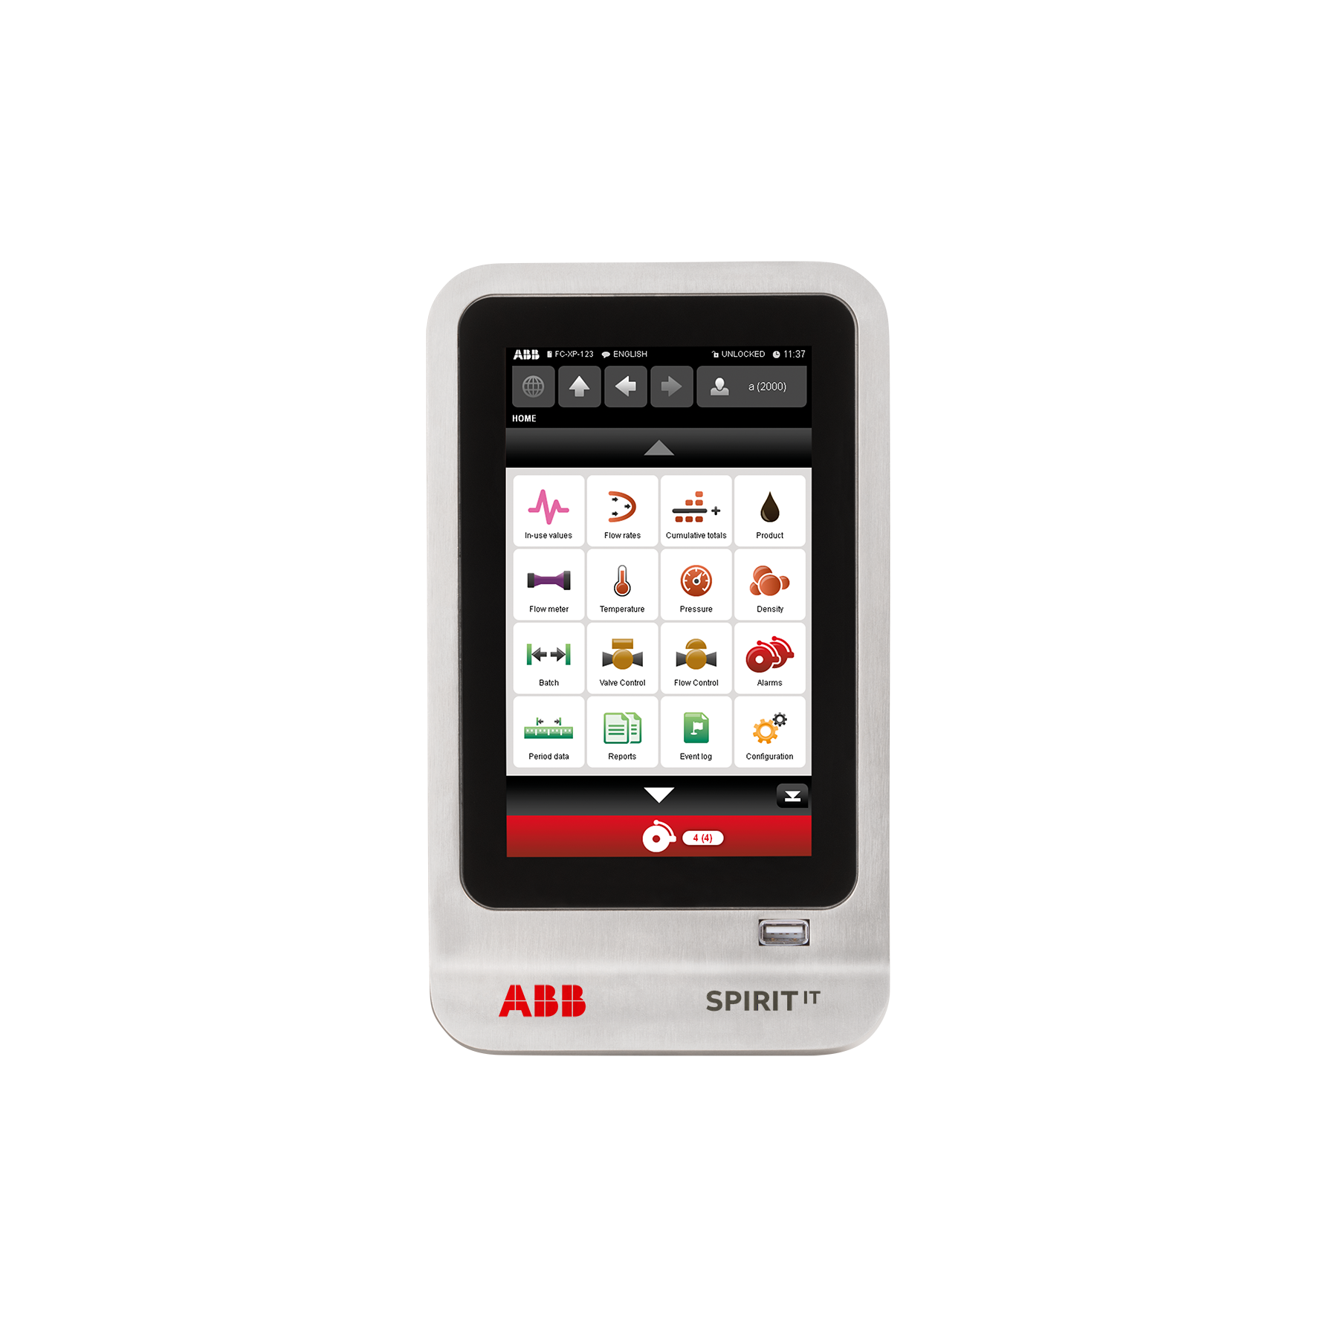
Compact panel mount flow computer

Slide 3
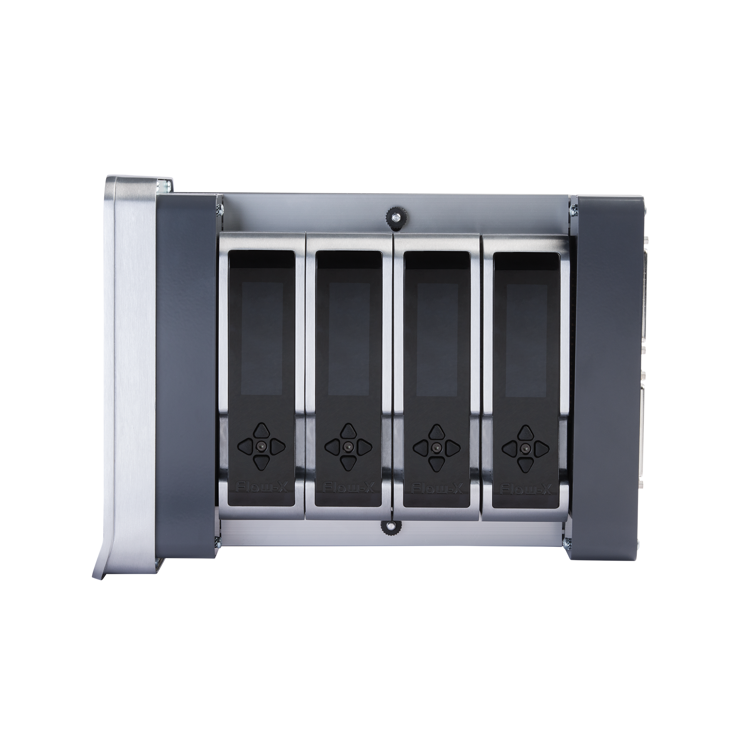
The Flow-X/C has one integral flow module
Flow-X/P
Flow-X/C

Slide 4
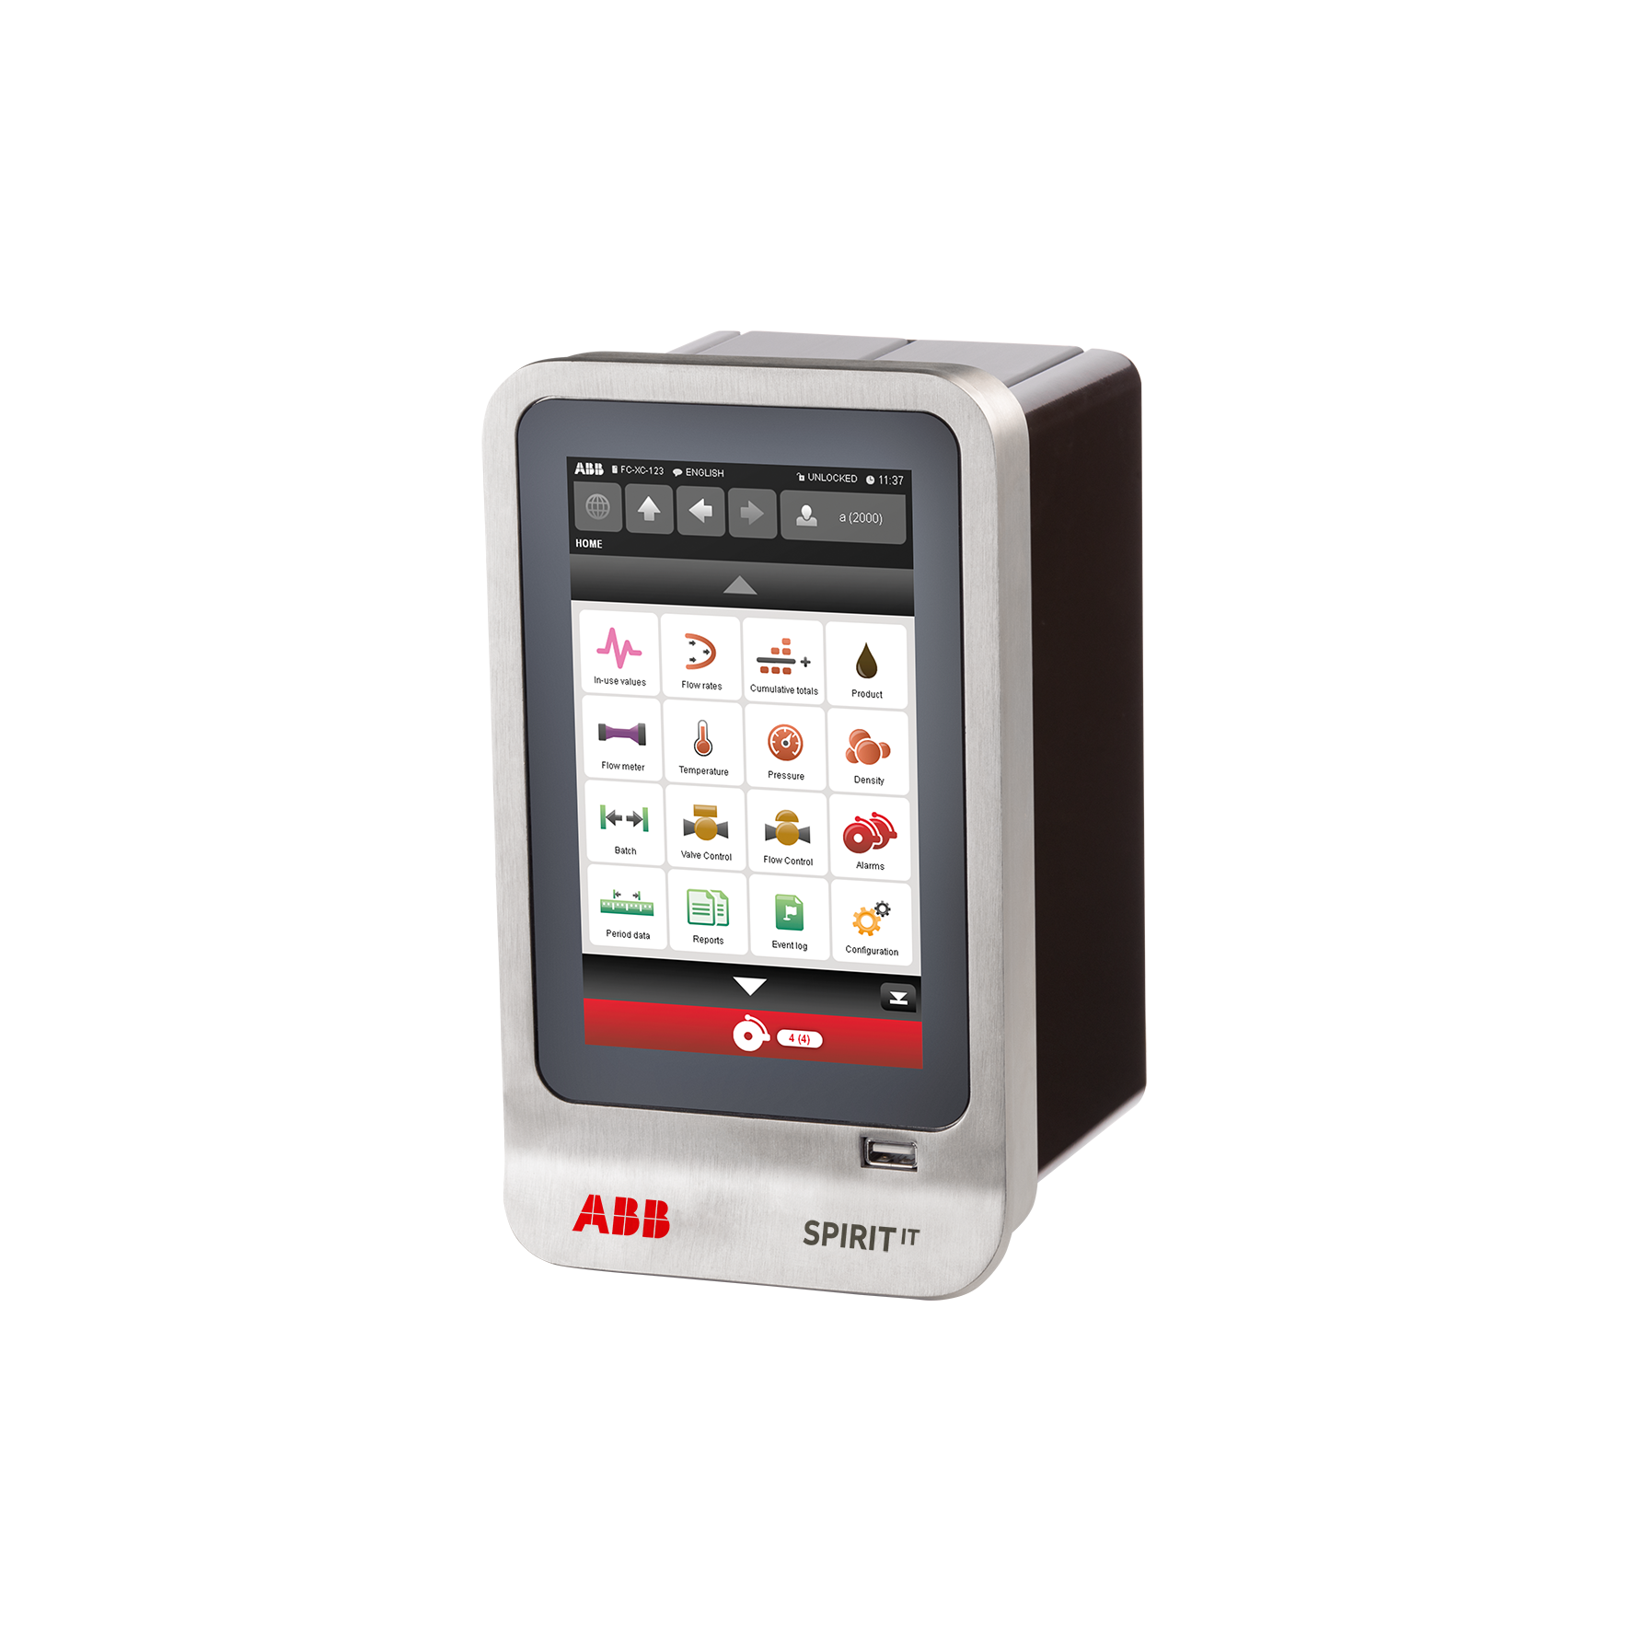
It is more cost-effective and more powerful
  More cost-effective⁽¹⁾
    Cost reduction of 23%
    Space reduction of 60%
    (1) Relative to a Flow-X/P1
  More powerful⁽²⁾
    200% more powerful CPU
    300% more RAM memory
    (2) Relative to the current Flow-X/P1.
    Later this year the Flow-X/P and Flow-X/M will also be upgraded to the same hardware as the Flow-X/C.

Slide 5
Ports and IO
6 analog inputs
4 HART inputs
2 Pt100 inputs
4 analog outputs
16 digital IO
2 Ethernet ports
3 serial ports
1 USB
Each of the 16 digital I/O channels can be assigned to a
pulse input (single/dual) max. 4⁽¹⁾
time period input (density) max. 4
prover detector input max. 4
status input max. 16
status output max. 16
pulse output (single/dual⁽²⁾) max. 4
prover bus output max. 1
Version 2 supports 4 dual pulse inputs, while version 1 supports one.
Version 2 supports MID approved dual pulse outputs to emulate flow meters

Slide 6
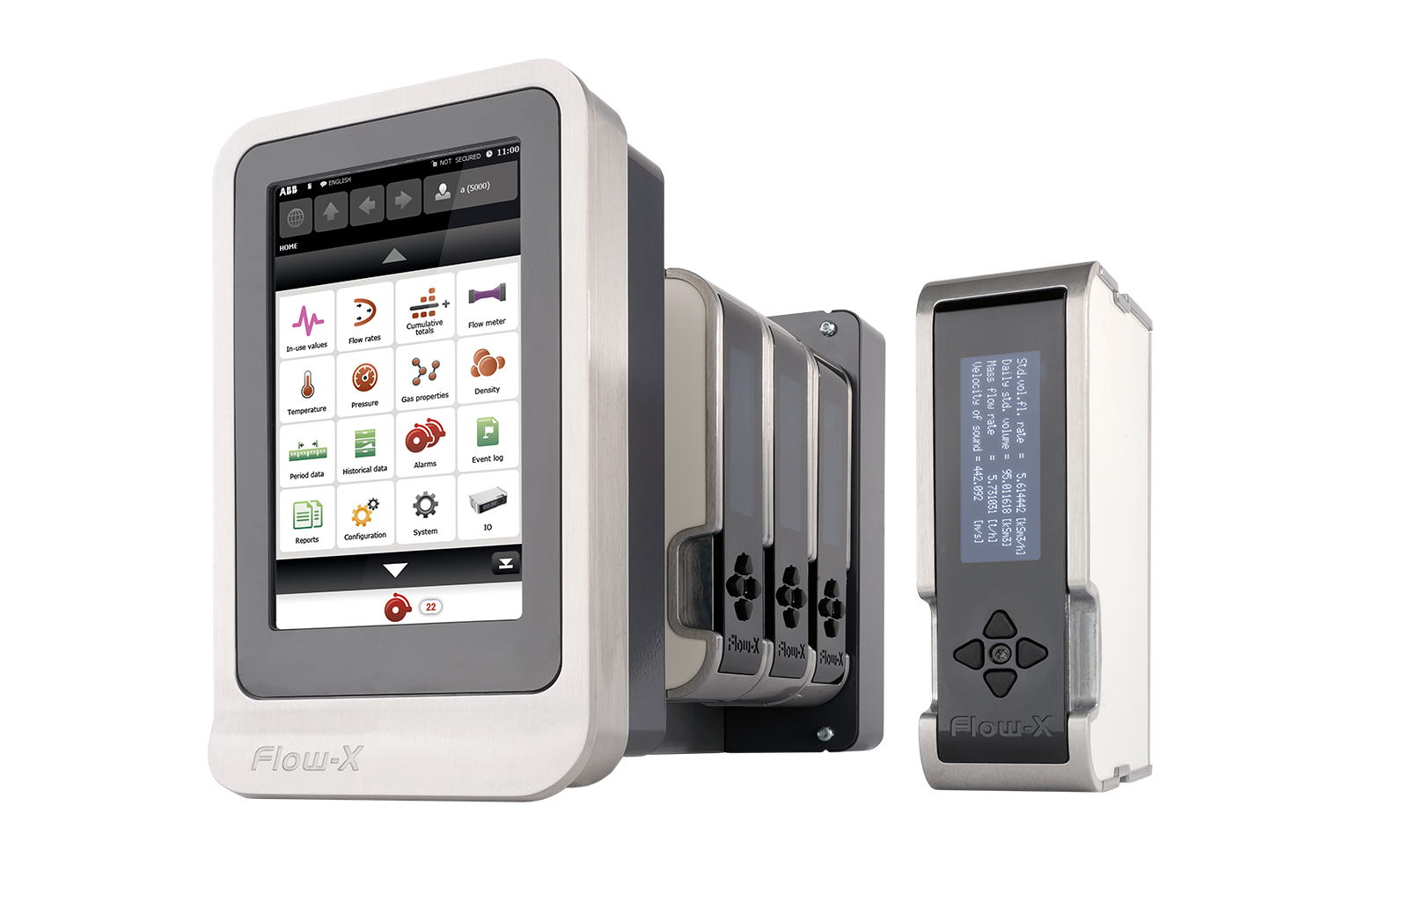
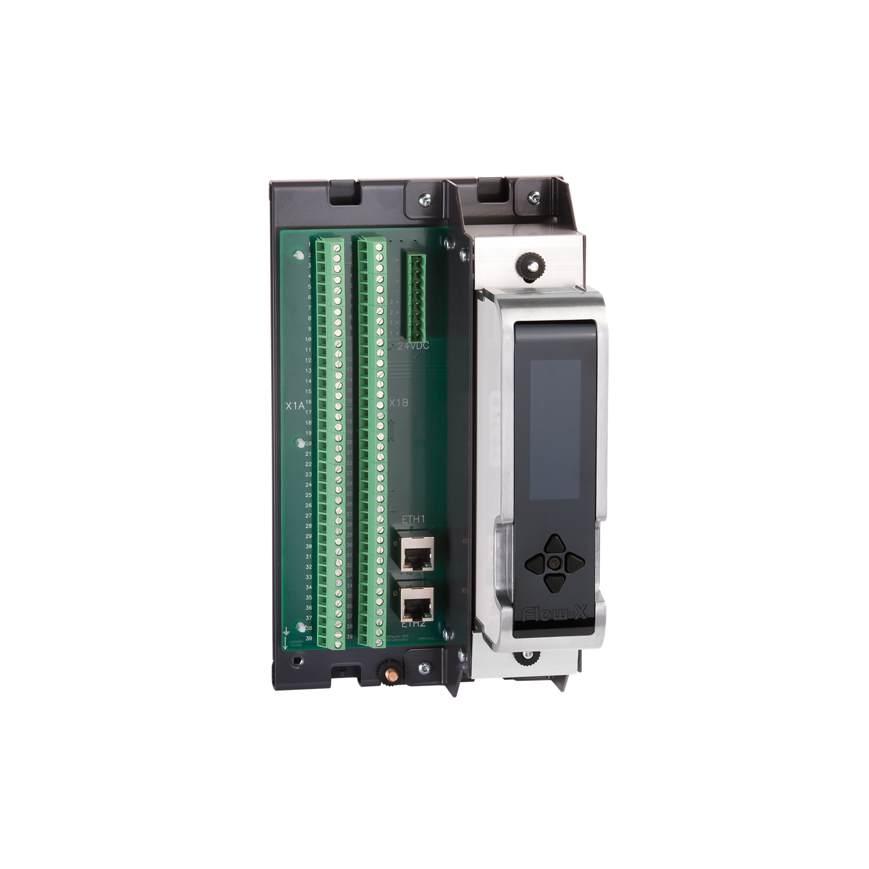
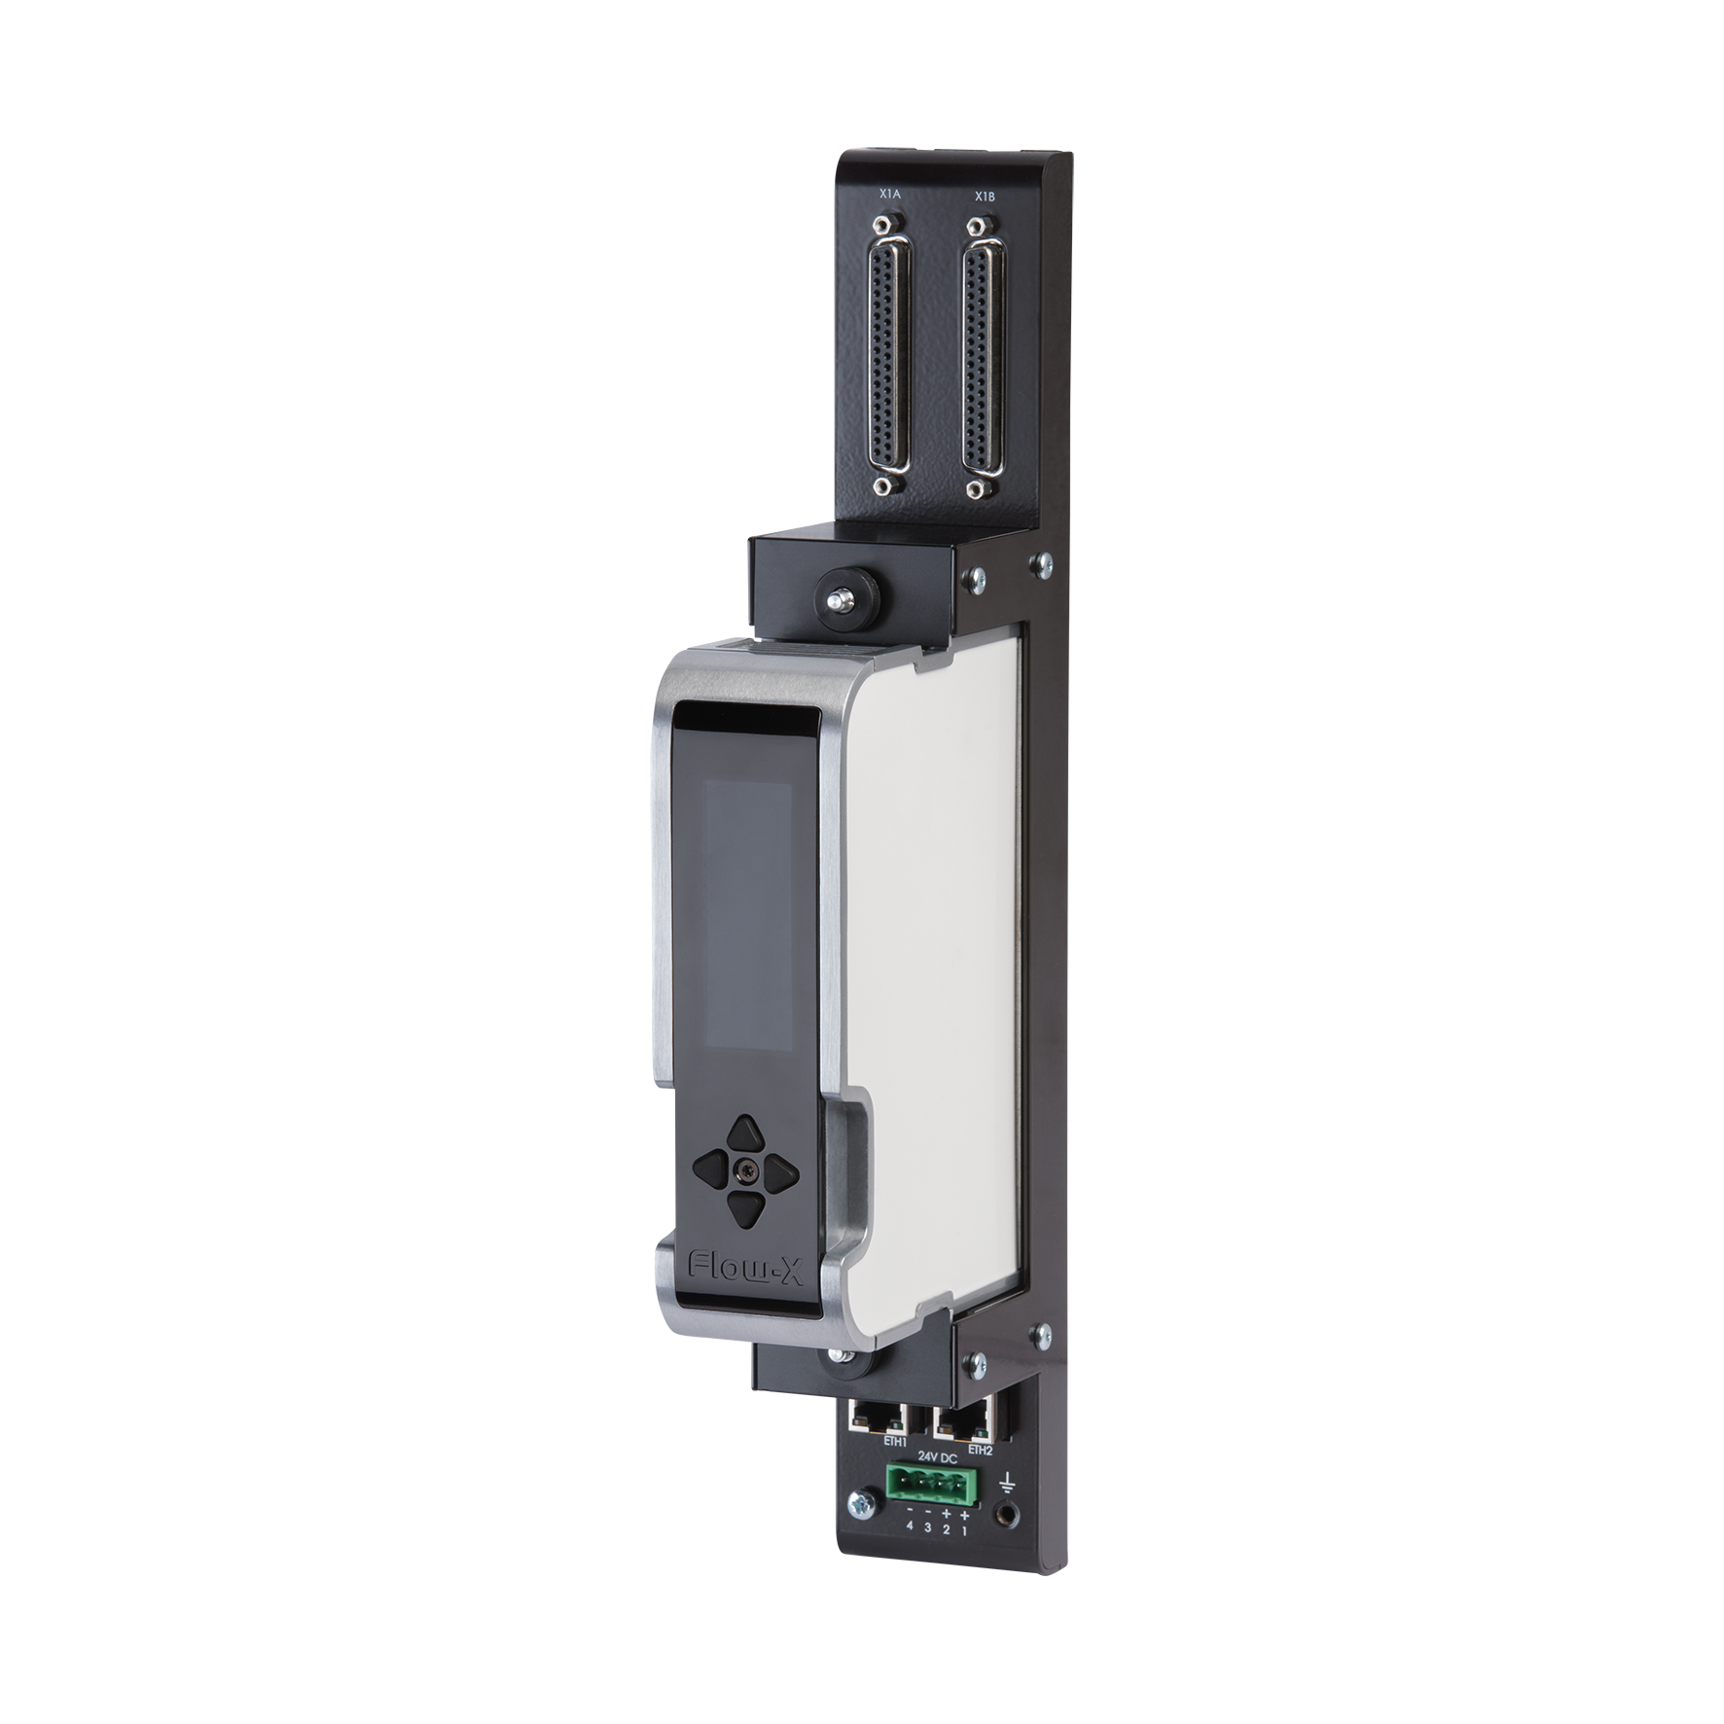
Price positioning
Flow-X/P1
Flow-X/C
Flow-X/K
Flow-X/S

Slide 7

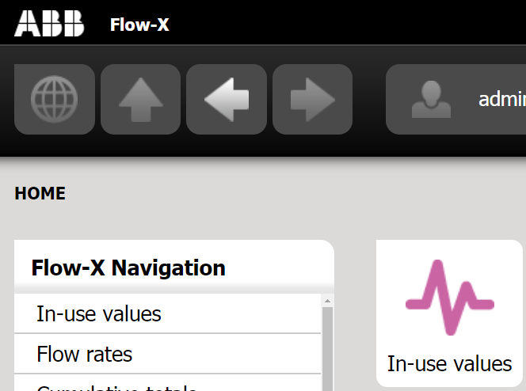

ABB Branding

Slide 8
With all the benefits of a Flow-X flow computer
The most accurate flow computer on the market
Extremely accurate 4-20 mA inputs
Supports the latest, most accurate calculations, e.g. AGA-8 Part 2
Strong security with personal user accounts
Excellent traceability
User-friendly operation, local and remote
MID certified for gas, liquid and also the software (Welmec 7.2)
Extensive metering and control functionality
Flexible communications, also to devices
Unique troubleshooting features
Controls the complete metering skid, no need for a PLC

